Slide 1
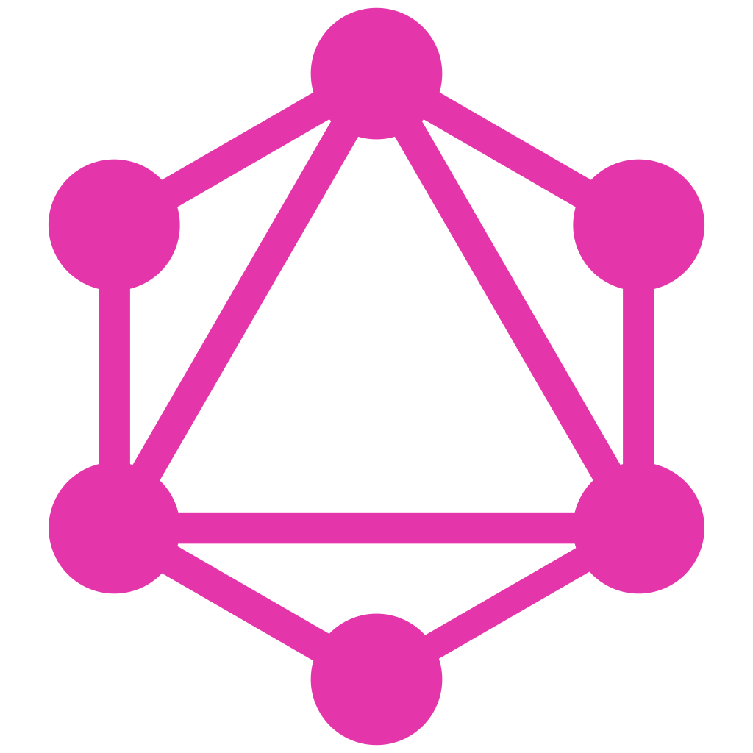
GraphQL 101
by R. Apú
June, 2023

Slide 2
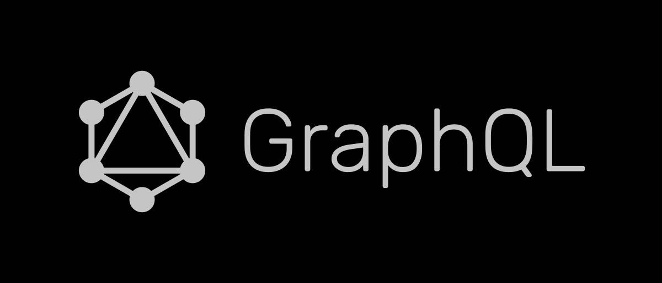
1
What?
2
Why?
GraphQL vs REST
3
How?
Architecture Examples

Slide 3
What is GraphQL?
?
Gorilla Logic Proprietary and Confidential

Slide 4
“a query language and execution engine originally created at Facebook in 2012 for describing the capabilities and requirements of data models for client-server applications.”
GraphQL Spec ( October, 2021)

Slide 5
GraphQL is…
GraphQL isn’ t…
… a standard of a language to communicate between clients and servers.
… self documented once an engine is deployed
… data source agnostic
… used in gateways in microservices archs.
… declarative
… used for both queries and data manipulation
…a programming language
… a relational database management language like SQL.
… implemented in a central repository.

Slide 6
Why use GraphQL?
?
Gorilla Logic Proprietary and Confidential

Slide 7
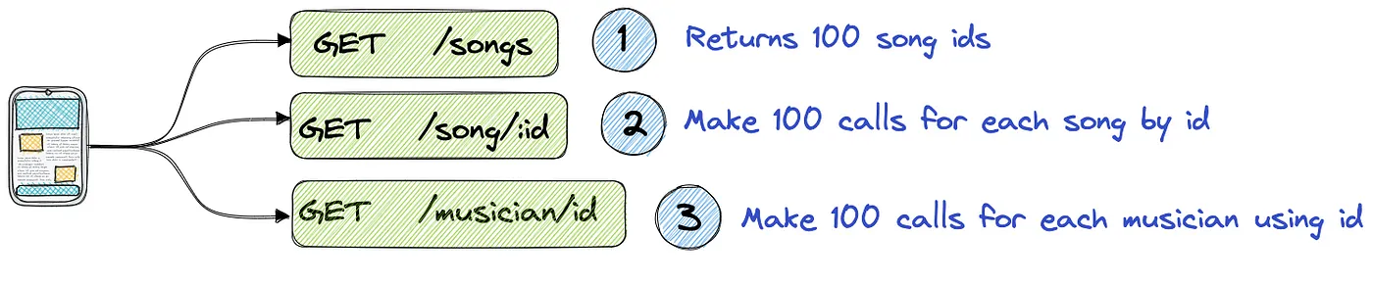
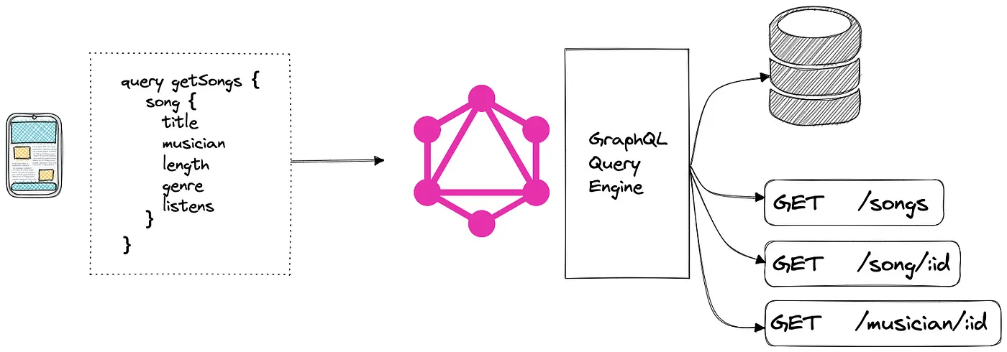
Reduces over fetching
FE sends as many RESTful requests as needed
5.73 in 10 in
FE sends declarative queries, i.e. gets only and exactly what it asks for

Slide 8
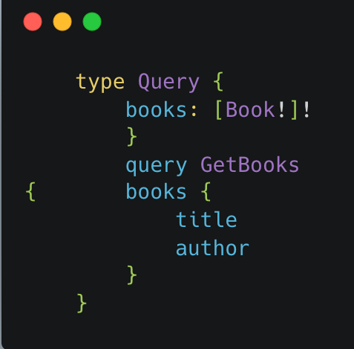
2. Strongly typed schemas
Language specifies:
types,
interfaces,
unions,
enums,
field arguments,
polymorphism,
3. Easier caching
Each field has its own resolver function

Slide 9
4. Self documented through introspection
FE sends as many RESTful requests as needed

Slide 10
5. Self documented through introspection

Slide 11
How does GraphQL Work?
?
Gorilla Logic Proprietary and Confidential

Slide 12
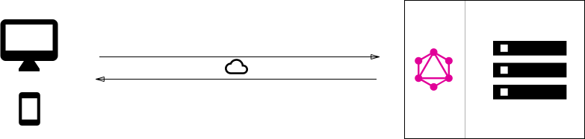
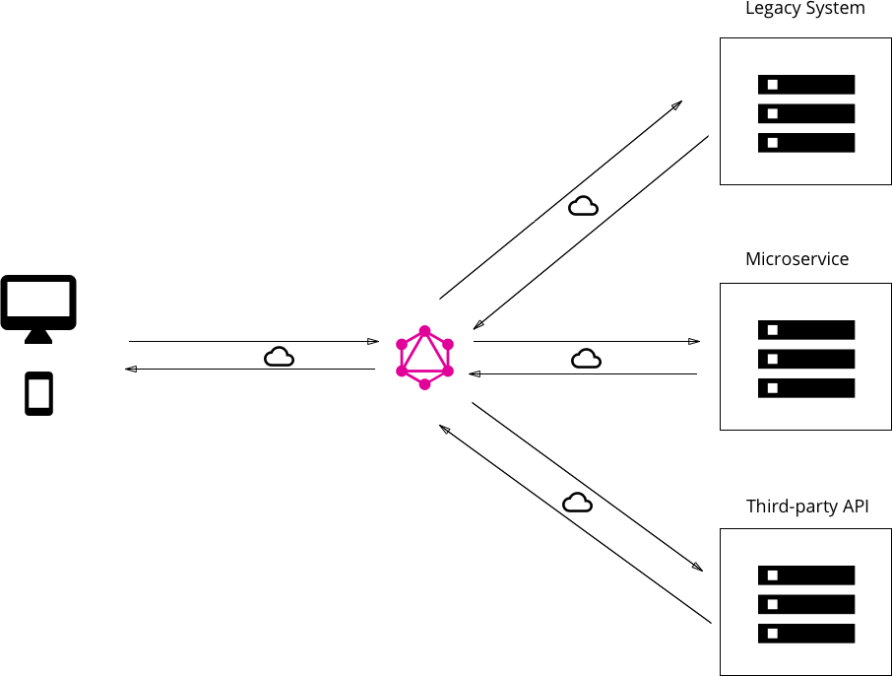
Architecture examples (6)
Embedded alongside the db engine and data.
Standalone gateway
Hybrid of 1 and 2
Analog of 3.
BFF
Authentication is important

Slide 13
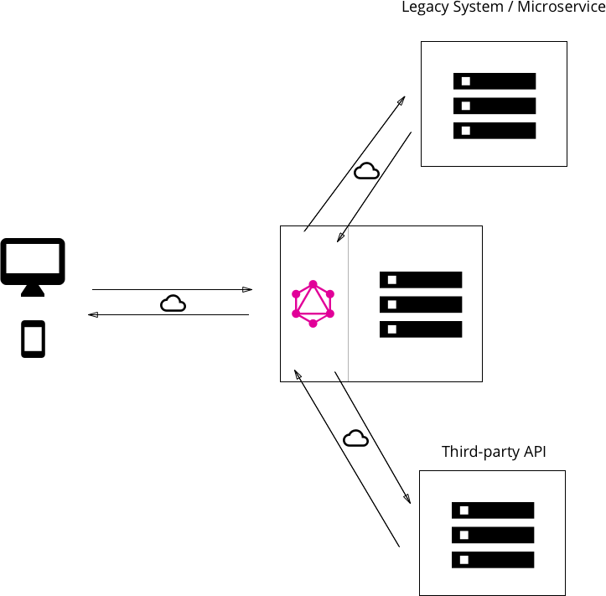
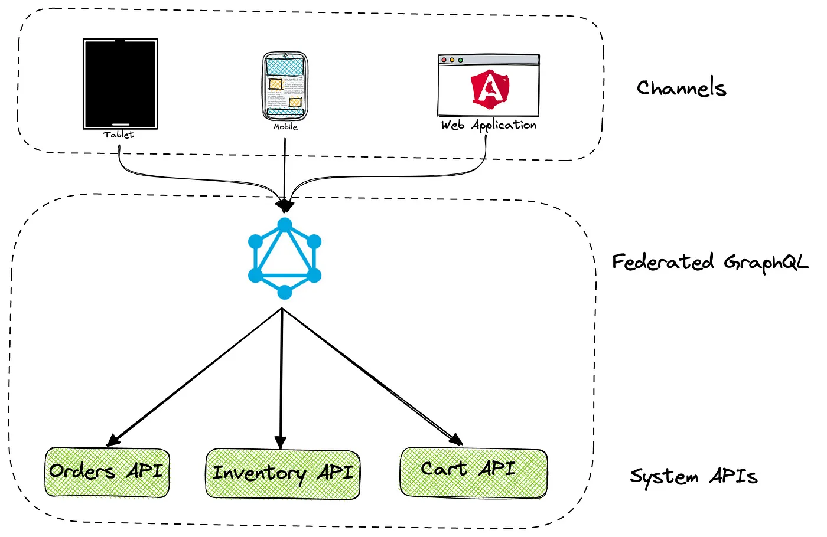
Hybrid approach
3.
4.

Slide 14
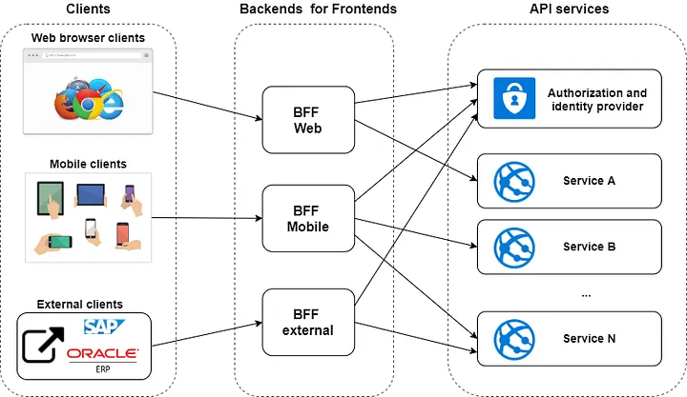
5. Backend for Frontend

Slide 15
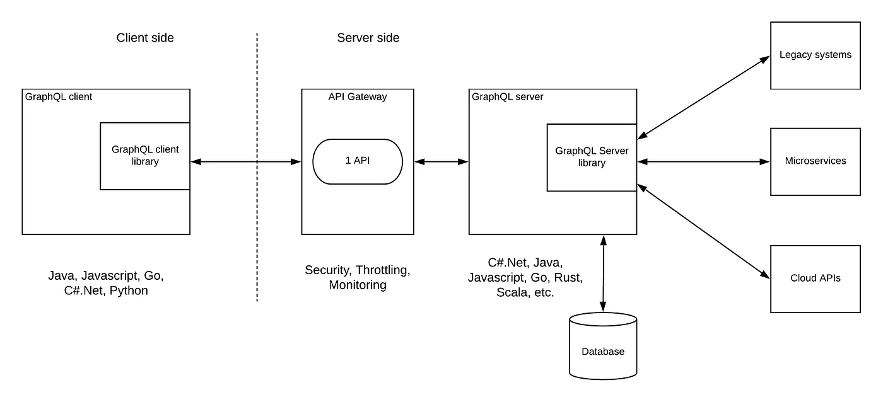
6. A more secure example:

Slide 16
BONUS: Schema Stitching
BO
Gorilla Logic Proprietary and Confidential

Slide 17
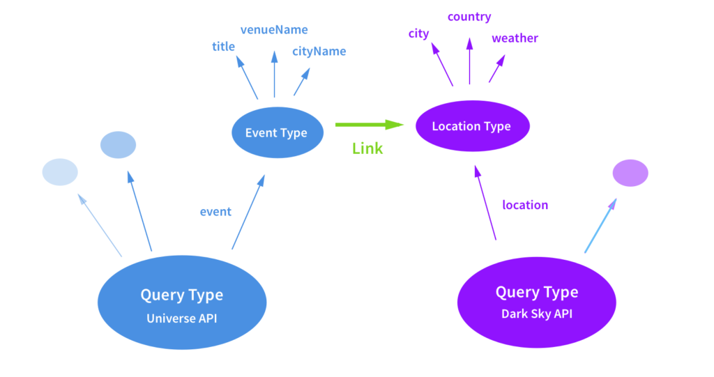
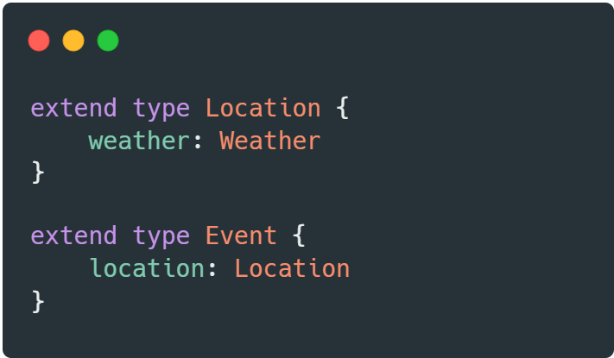
Schema stitching (cont.)
Related models in different APIs can be linked in a server environment to save resources in client machines
graphql-tools by The Guild

Slide 18
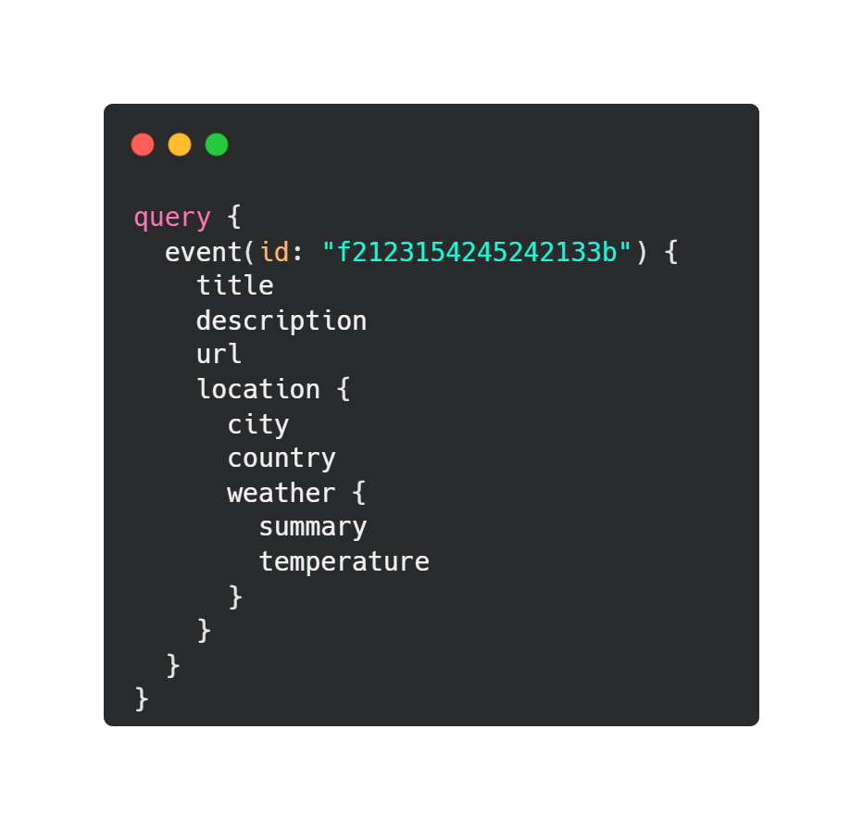
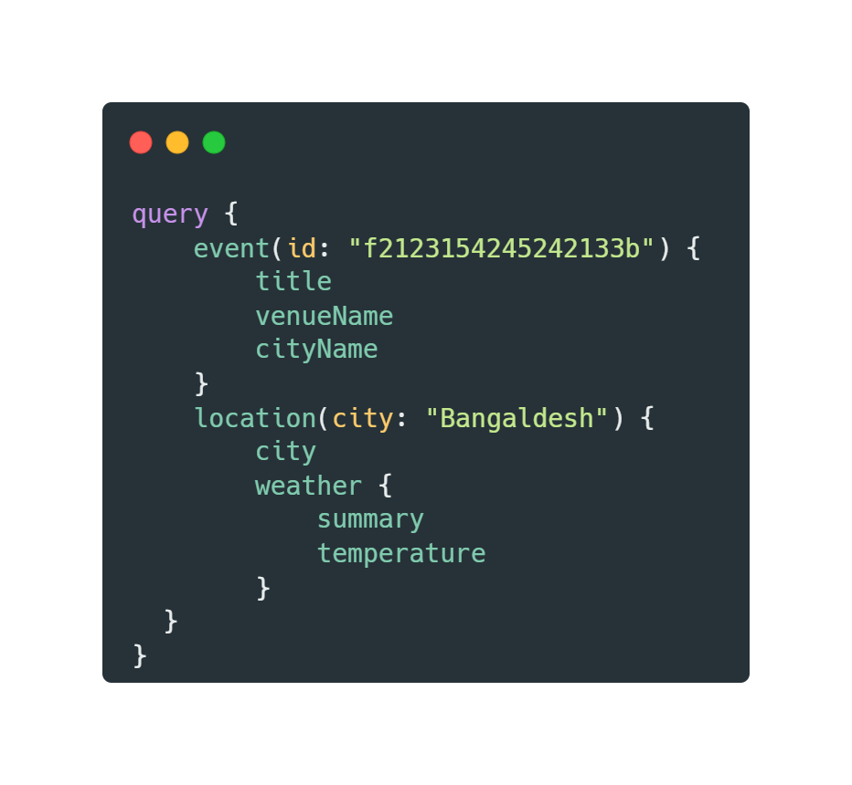
Schema stitching (cont.)
Related models in different APIs can be linked in a server environment to save resources in client machines
graphql-tools by The Guild

Slide 19
Recap

Slide 20
Thank You!
Additional Resources

